Slide 1

Image Processing
Notes:
‹#›

Slide 2
Objectives
What is image processing?
How does image processing work?
Applications of image processing.

Slide 3
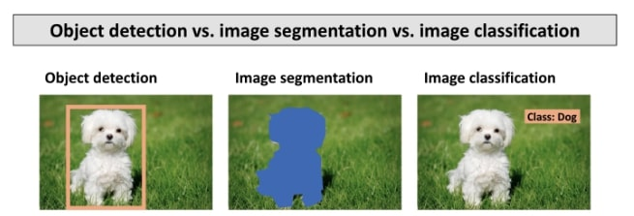
What is Image Processing?
The approach of manipulating an image to either enhance the quality of an image or extract useful information from the image for further operations.
Frequently used in the industry for visualization, information extraction, pattern recognition, classification, segmentation, etc.
Can be used to classify what an object is just by having a mathematical algorithm analyze the array of pixels in an image and compare the data to known feature vectors for the classification to occur.

Slide 4
How Does Image Processing Work?
Image acquisition: sensors capture and digitize images.
Image enhancement: details are brought out to enhance results.
Image restoration: appearance of the image is improved.
Color image processing: colors are used to extract features of interest.
Wavelets and multiresolution processing: represent images in variety of degree resolutions.

Slide 5
How Does Image Processing Work?
Compression: reduce storage to save the image.
Morphological processing: image features that are useful for shape and representation are extracted.
Image segmentation: images are partitioned into specific objects.
Representation and description: labels are assigned to an object based on the description.
Knowledge base: knowledge database is finally created based on coded knowledge in an image processing system.

Slide 6
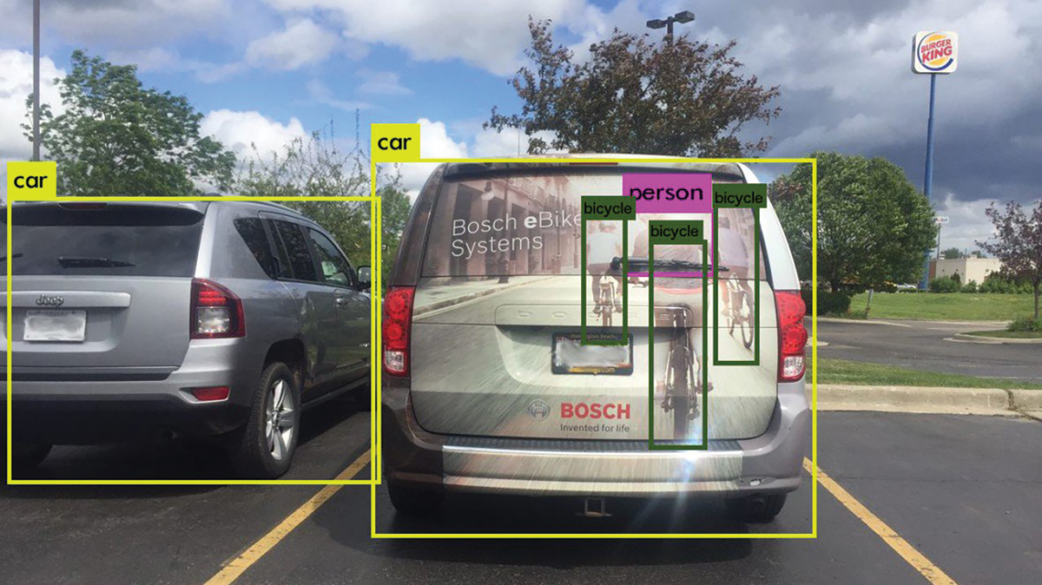
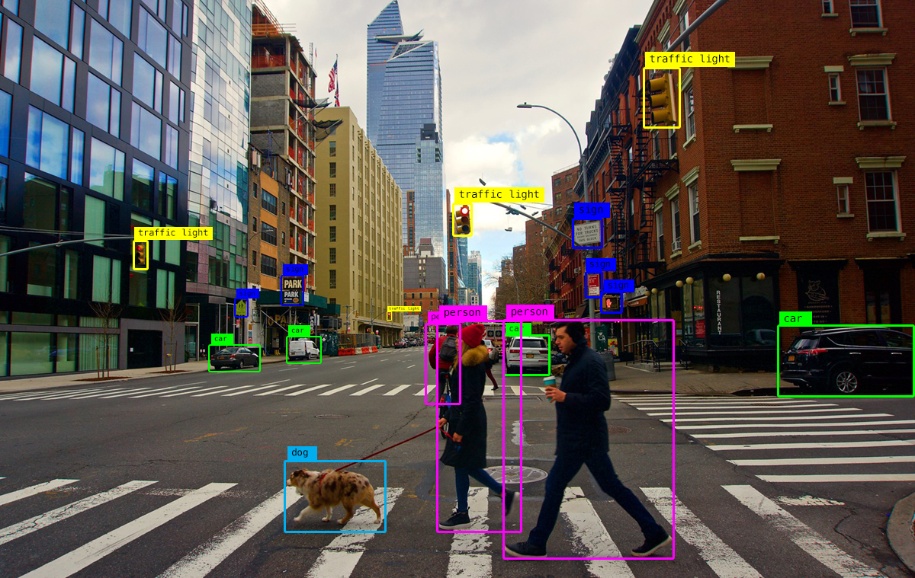
Applications of Image Processing

